Slide 1

School of Computing Science and Engineering Course Code : BCSE3032 Course Name: SE & TM
UNIT-2
Software Requirement Specifications (SRS) and Design:
Entity Relationship Diagrams
Program Name: B.Tech

Slide 2
School of Computing Science and Engineering Course Code : BCSE3032 Course Name: SE & TM
What Entity relationship diagrams (ERD) are.
What Entities in an ERD are?
What Attributes in an ERD are?
What Relationships in an ERD are?
How to start an ERD .
Program Name: B.Tech

Slide 3
School of Computing Science and Engineering Course Code : BCSE3032 Course Name: SE & TM
Entity-Relationship Data Model (ERM) is a detailed, logical representation of the data for an organization or for a business area.
Expressed in terms of:
Entities
Attributes
Relationships
Entity-Relationship Diagram (ERD) is a graphical representation of a Entity-Relationship Model.
Program Name: B.Tech

Slide 4
School of Computing Science and Engineering Course Code : BCSE3032 Course Name: SE & TM
The purpose of an ERD is to capture the richest possible understanding of the meaning of data necessary for an information system or organization.
ERDs are made from Entities, Attributes, and Relations.
Program Name: B.Tech

Slide 5
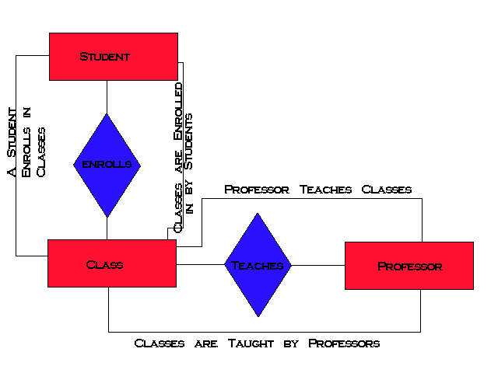
School of Computing Science and Engineering Course Code : BCSE3032 Course Name: SE & TM
Program Name: B.Tech

Slide 6
School of Computing Science and Engineering Course Code : BCSE3032 Course Name: SE & TM
What is an Entity?
Has its own identity that distinguishes it from other entities.
Examples:
Person: PROFESSOR, STUDENT
Place: STORE, UNIVERSITY
Object: MACHINE, BUILDING
Event: SALE, REGISTRATION
Concept: ACCOUNT, COURSE
Program Name: B.Tech

Slide 7
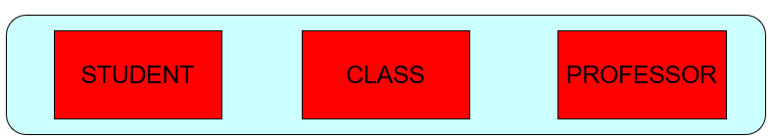

School of Computing Science and Engineering Course Code : BCSE3032 Course Name: SE & TM
Entity Type is a collection of entities that share common properties or characteristics.
Entity Instance is a single occurrence of an entity type.
Entities should always be placed in a rectangle!
Program Name: B.Tech

Slide 8
School of Computing Science and Engineering Course Code : BCSE3032 Course Name: SE & TM
Entity type name should be:
A singular noun and in capital letters.
Descriptive and specific to the organization.
Concise.
Named for the result of the event, not the activity or process of the event.
Program Name: B.Tech

Slide 9
School of Computing Science and Engineering Course Code : BCSE3032 Course Name: SE & TM
Program Name: B.Tech

Slide 10
School of Computing Science and Engineering Course Code : BCSE3032 Course Name: SE & TM
An Entity type definition should:
Include a statement of what the unique characteristics are for each instance.
Make clear what entity instances are included and not included.
Include a description of when an instance of the entity type is created and deleted.
Specify when an instance might change into an instance of another entity type.
Specify what history is to be kept about entity instances.
Program Name: B.Tech

Slide 11
School of Computing Science and Engineering Course Code : BCSE3032 Course Name: SE & TM
Each Entity has a set of Attributes
Attribute is a property or characteristic of an entity that is of interest to the organization.
Example:
STUDENT: Student_ID, Student_Name, Phone_Number, Major
Program Name: B.Tech

Slide 12
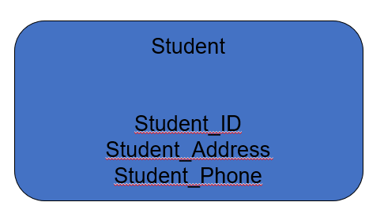
School of Computing Science and Engineering Course Code : BCSE3032 Course Name: SE & TM
Program Name: B.Tech

Slide 13
School of Computing Science and Engineering Course Code : BCSE3032 Course Name: SE & TM
An attribute name:
Should be a noun and capitalize the first letter of each word. (Example: Student_ID.)
Should be unique.
Should follow a standard format. (Example: Student_GPA, not GPA_of_Student.)
Similar attributes of different entity types should use similar but distinguished names.
Example: Faculty_Residence_City_Name and Student_Residence_City_Name
Program Name: B.Tech

Slide 14
School of Computing Science and Engineering Course Code : BCSE3032 Course Name: SE & TM
An attribute definition should:
State what the attribute is and why it is important.
Make clear what is and isn’t included in the attribute's value.
Define any aliases.
Indicate if the attribute is required or not.
Indicate any relationships with other attributes.
Program Name: B.Tech

Slide 15
School of Computing Science and Engineering Course Code : BCSE3032 Course Name: SE & TM
Candidate Key = is an attribute that uniquely identifies each instance of an entity type.
Identifier = A candidate key that has been selected as the unique, identifying characteristic of an entity type. (Should be underlined).
Other types of Attributes: multivalued, required, optional, composite, and derived.
Program Name: B.Tech

Slide 16
School of Computing Science and Engineering Course Code : BCSE3032 Course Name: SE & TM
Choose a candidate key that will not change its value.
Choose a candidate key that has valid values and not be null.
Avoid using codes, such as a 2 digit warehouse location.
Program Name: B.Tech

Slide 17
School of Computing Science and Engineering Course Code : BCSE3032 Course Name: SE & TM
Relationships are associations between one or more entity types.
Are the “glue” that holds together components of an E-R model.
The degree of a relationship = is the number of entity types that participate in a relationship.
There are 3 common relationships:
Unary (degree one)
binary (degree two)
Ternary (degree three)
Program Name: B.Tech

Slide 18
School of Computing Science and Engineering Course Code : BCSE3032 Course Name: SE & TM
Program Name: B.Tech

Slide 19
School of Computing Science and Engineering Course Code : BCSE3032 Course Name: SE & TM
A relationship name should:
Be a verb phrase, such as Is_assigned_to.
Avoid vague names, such as “Has”.
Program Name: B.Tech

Slide 20
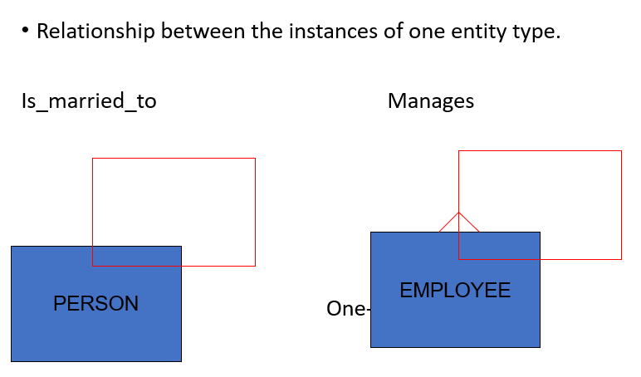
School of Computing Science and Engineering Course Code : BCSE3032 Course Name: SE & TM
Program Name: B.Tech

Slide 21
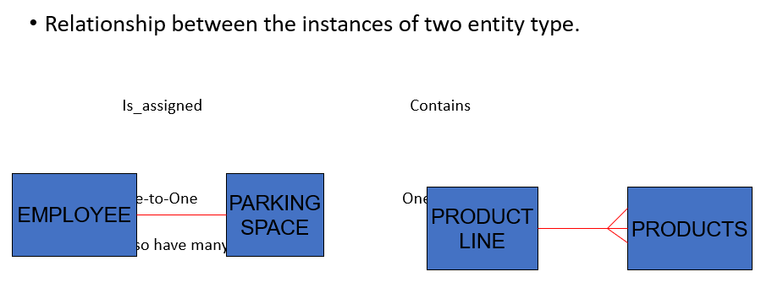
School of Computing Science and Engineering Course Code : BCSE3032 Course Name: SE & TM
Program Name: B.Tech

Slide 22
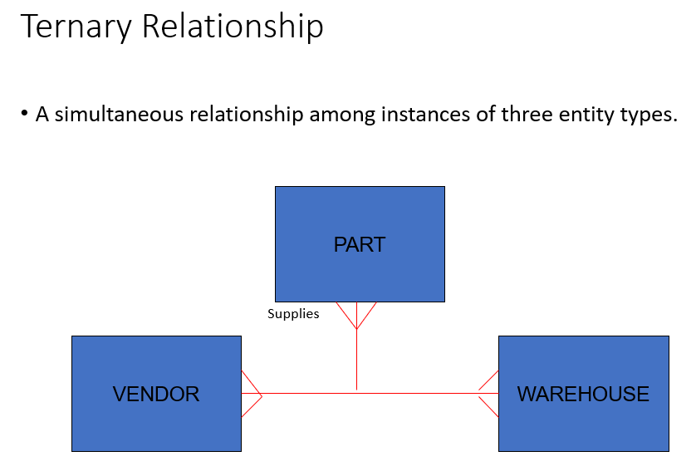
School of Computing Science and Engineering Course Code : BCSE3032 Course Name: SE & TM
Program Name: B.Tech

Slide 23
School of Computing Science and Engineering Course Code : BCSE3032 Course Name: SE & TM
Mandatory Cardinalities = The entity must participate in another entity.
Optional Cardinalities = The entity has a the option to participate in another entity.
Program Name: B.Tech

Slide 24
School of Computing Science and Engineering Course Code : BCSE3032 Course Name: SE & TM
Define the Entities.
Define the Relationships.
Add attributes to the relationships.
Add cardinality to the relationships.
Don’t forget to use proper naming conventions and symbol representation.
Program Name: B.Tech

Slide 25
School of Computing Science and Engineering Course Code : BCSE3032 Course Name: SE & TM
Lay out the diagram with minimal line crossing.
Place subject entity types on the top of the diagram.
Place plural entity types below a single entity type in a one-to-many relationship.
Place entity types participating in one-to-one and many-to-many relationships alongside each other.
Group closely related entity types when possible. Try to keep the length of relationship lines as short as possible. Also try to minimize the number of changes of direction in a single line.
Show the most relevant relationship name. One name must always be shown.
Program Name: B.Tech

